Slide 1


Slide 2

Carlos Concepcion
Timothy Hinga
Reis Taylor Deepika Chandran
Synergy Ladder

Slide 3

Use Case
A shoe wholesaler that uses 3D printing technology to manufacture their wares. Printing inexpensive shoes with unique and original designs.
Prototype/Design Integration
Approval Process for Designs
Product Display
Accounts with multiple branches

Slide 4

Software Development Lifecycle
Scrumban
Short Sprint
Kanban Board
Daily Standups
Tools
Declarative:
Lightning App Builder
Flow Builder
Programmatic:
Apex
VisualForce
SOQL, SOSL, DML
Notes:
Platform such as Flow Builder, and
Platform such as Flow Builder, and

Slide 5
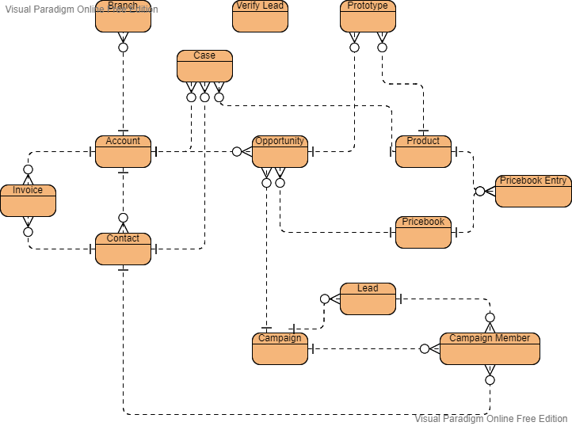
Data Model

Slide 6

Organization Wide Security
Setup 3 Profiles: Sales, Service, Executive
Login Hours, IP Ranges
Configured Object & Field Security
Hiding sensitive information
Giving powers to executives

Slide 7
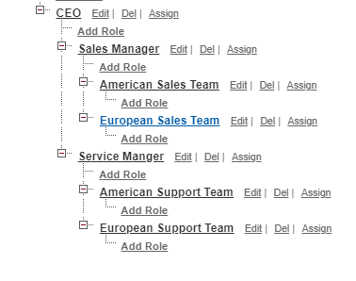
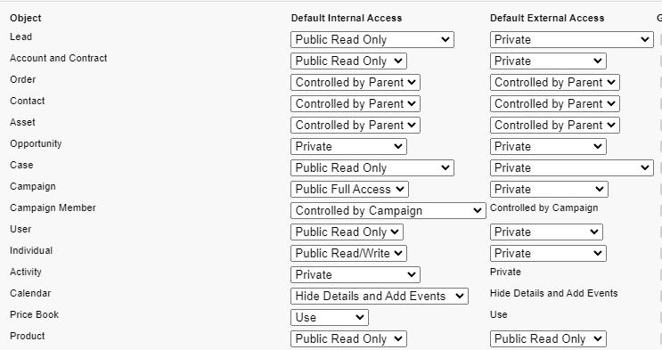
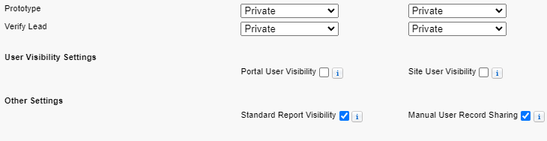
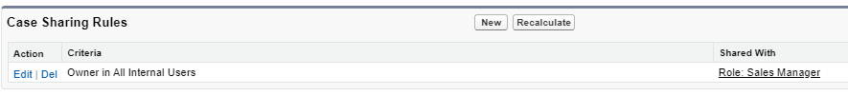
Record Level Security
15,035 (15,000 max)

Slide 8

Design Process Automation
Streamline Custom Designs
Readily offer to all
Automate every step
Immediately publish news

Slide 9
Quick Demo
Flows & Apex

Slide 10
Sales Cloud And Service Cloud
Lead and Case Assignment Rules
Lead and Case Auto Response Rules
Web to Lead and Web to Case
Path on Opportunity,Case and Prototype Objects
Screenflow on Lead Object

Slide 11
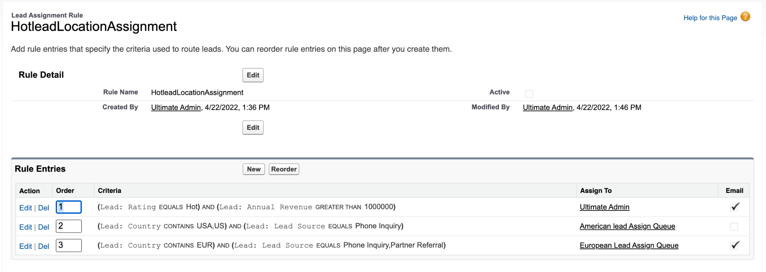
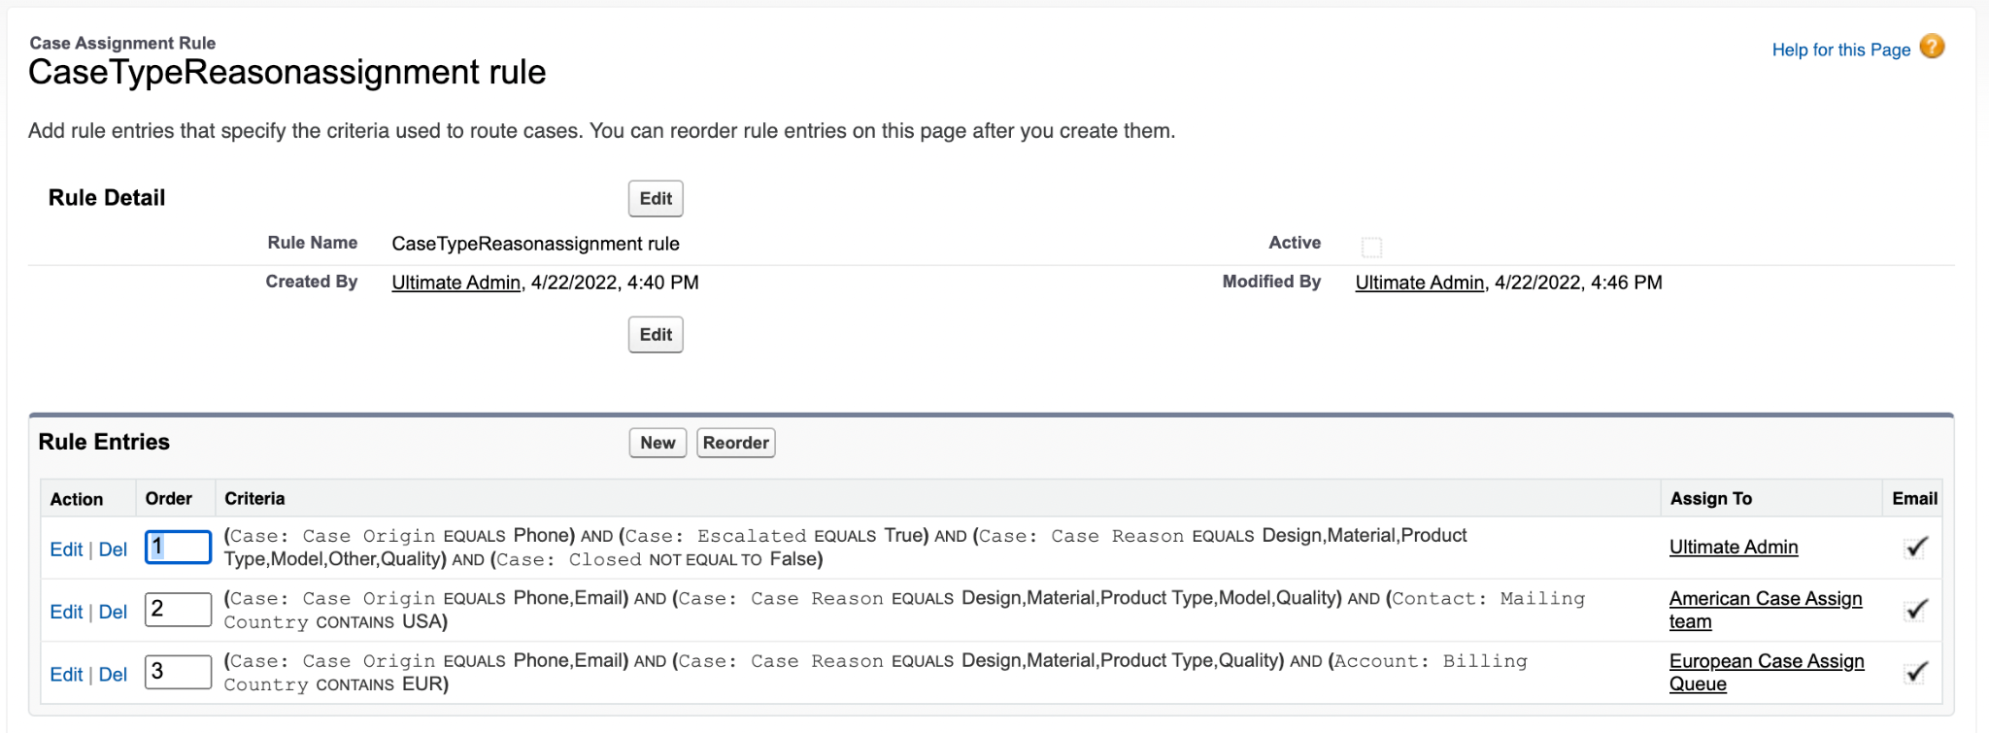
Lead and Case Assignment

Slide 12
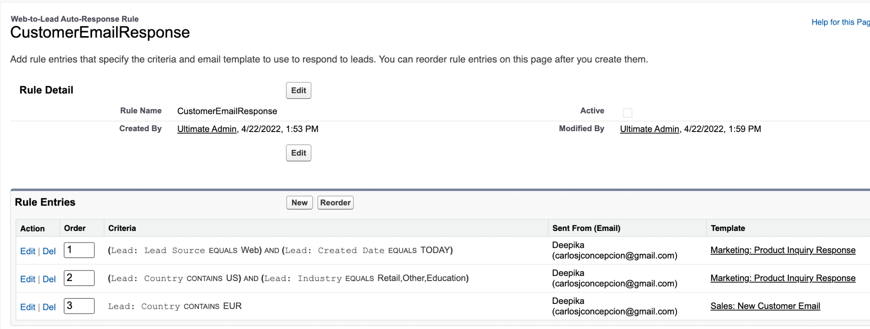
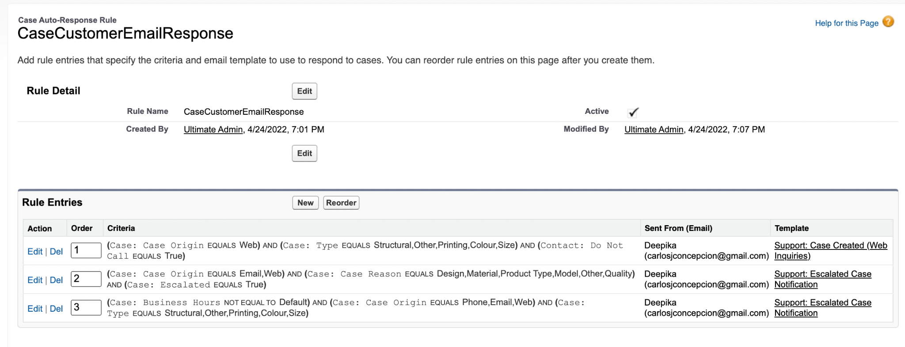
Lead and Case Auto Response

Slide 13
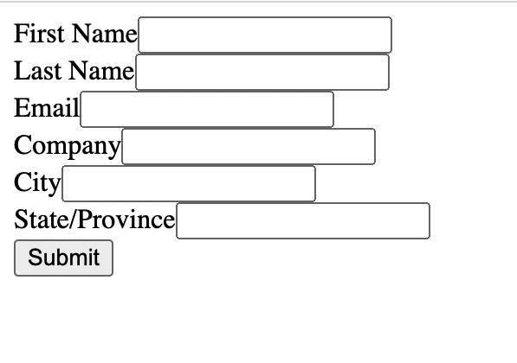
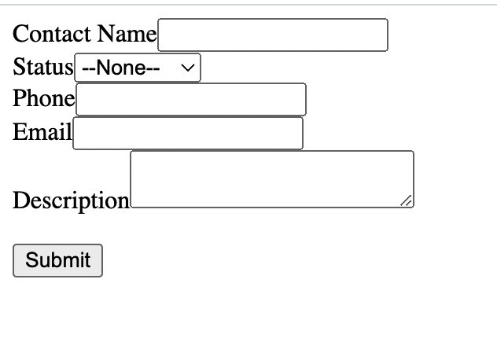
Web to Lead Web to case

Slide 14
Demo
Apex Trigger /Handler Class/Test Class/VisualForce Page

Slide 15
Objective Overview
Design Tools: Honorable Mention
Reports Dashboards & Analytics
Before delete trigger & custom Object with real-life use case
Schedule triggered flow with collections variable
External API Salesforce Integration Displayed with Visualforce Page
Postman
JSON Viewer
VS Code
Maps of maps of maps
And words of warning for those considering untyped deserialization

Slide 16
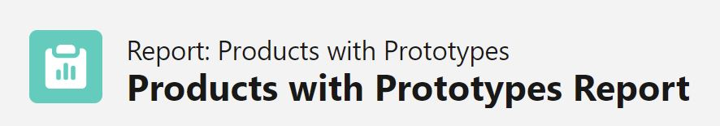
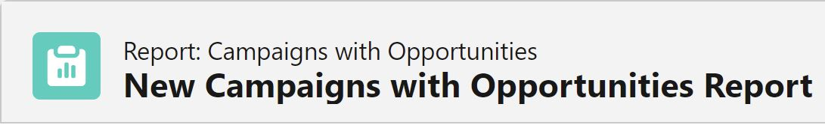
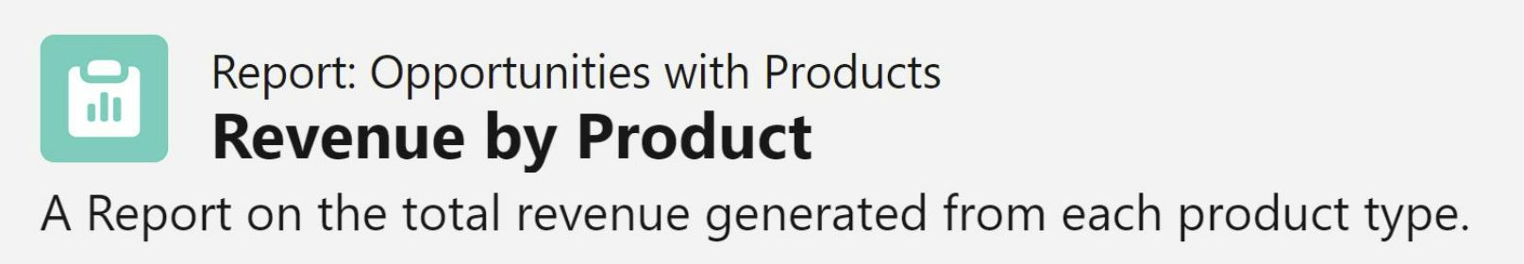

Slide 17
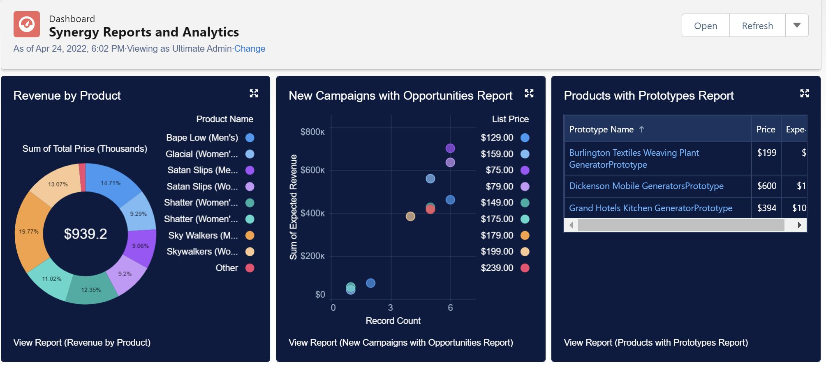
Reports and Dashboards

Slide 18
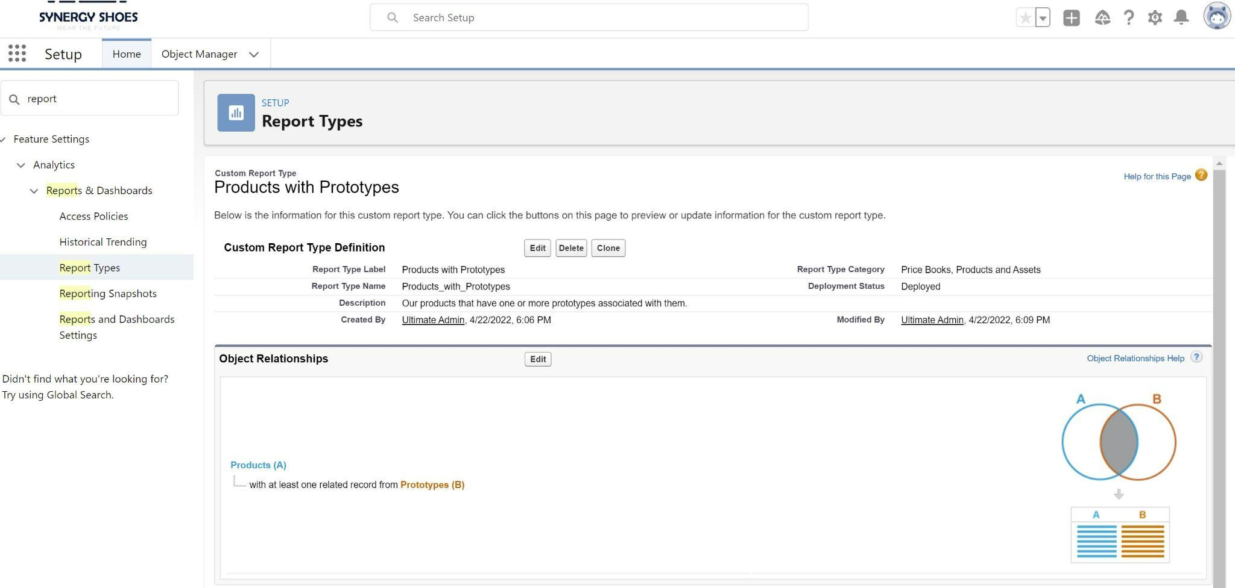

Slide 19
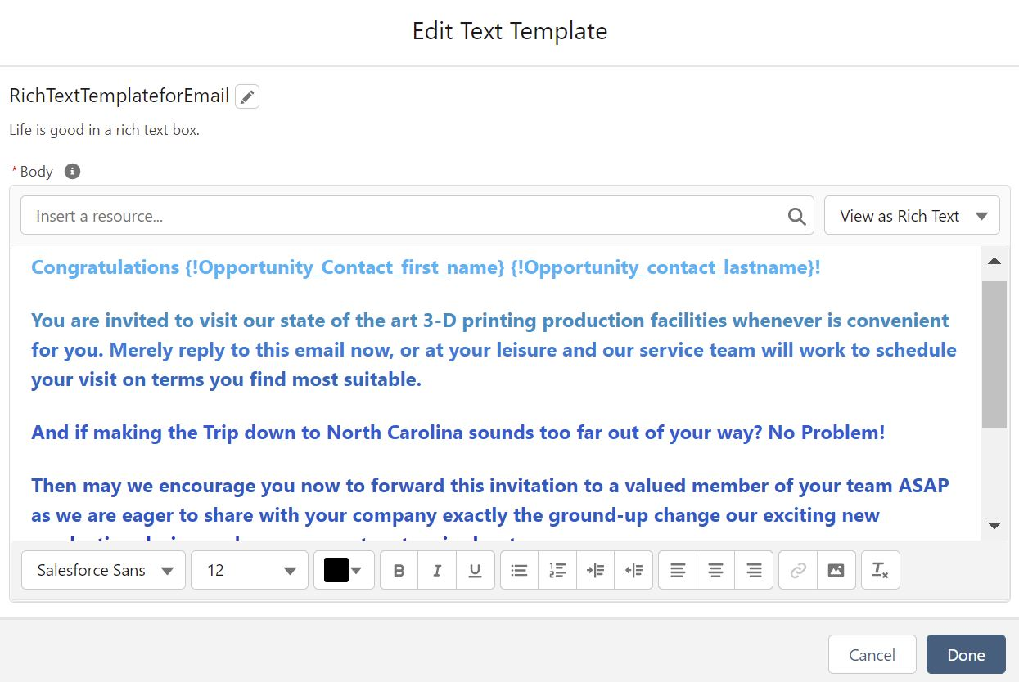
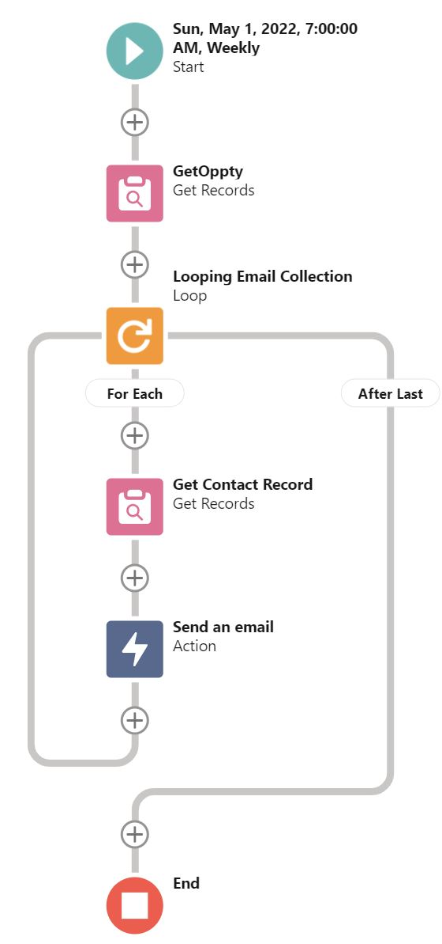
Schedule-Triggered Flow Utilizing a Collection Variable Resource of Type Opportunity

Slide 20
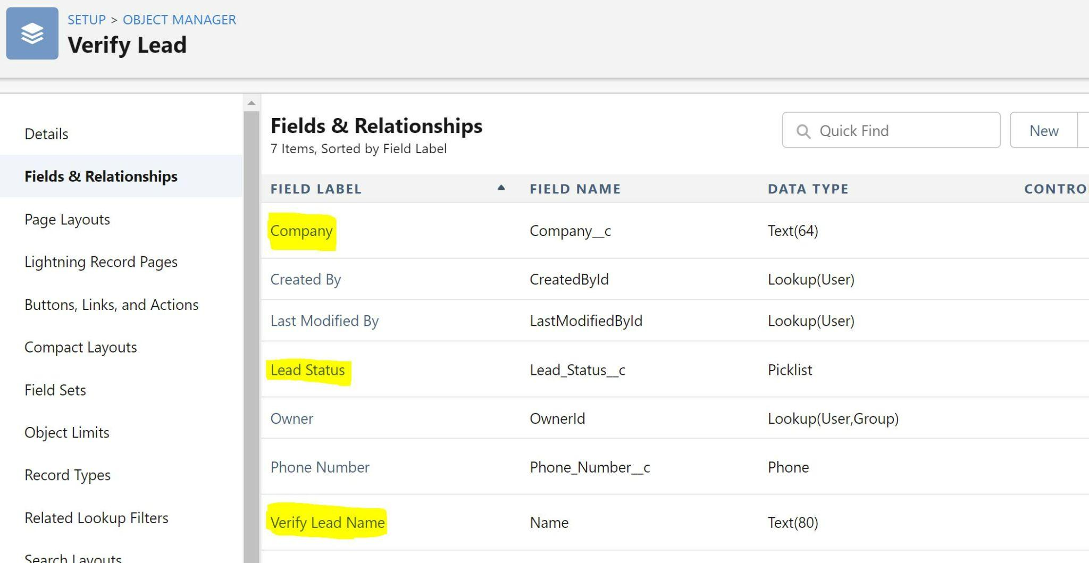
Verify Lead - One of Synergy’s Custom Objects

Slide 21
Thank You for Your Time and Attention

